Slide 1

Human Vs Robot
Conde Nast Bidder Prediction
PREDICT IF AN ONLINE BID IS MADE BY A MACHINE OR A HUMAN

Slide 2

Overview
You'll be chasing down robots for an online auction site.
In order to rebuild customer happiness, the site owners need to eliminate computer generated bidding from their auctions.
Their attempt at building a model to identify these bids using behavioral data, including bid frequency over short periods of time, has proven insufficient.
The goal is to identify “robots” which are making bids, helping the site owners easily flag these users for removal from their site to prevent unfair auction activity.

Slide 3
Preliminary plan
Get familiar with data
Create features
Select the most important features
Try different models & parameters
Compare, improve
Submit
Repeat

Slide 4
Platforms
◦ Data analysis Python (Jupyter Notebook + PyCharm) ◦ Feature engineering (pandas, numpy)
◦ Analyzing & visualisation (^ + matplotlib, seaborn)
◦ Building models (sklearn.ensemble, xgboost, random forest, Decision tree) ◦ Comparing (sklearn.model_selection) ◦ Scoring (sklearn.metrics)

Slide 5
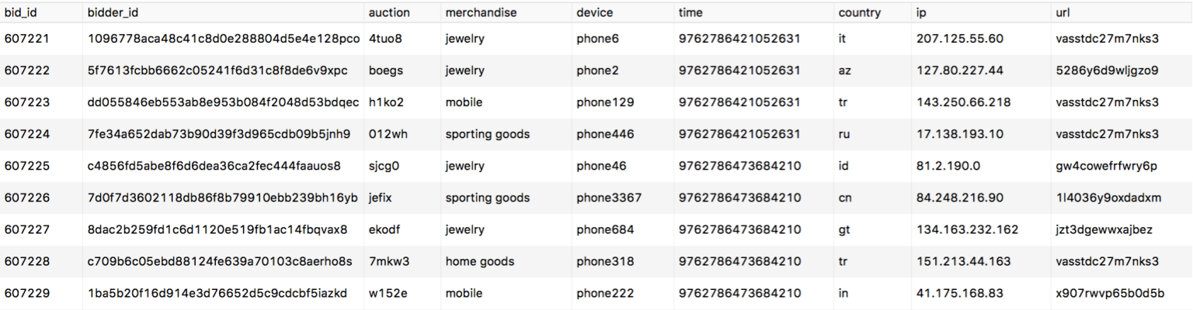
Understanding data: Bids
bids table (size: 7 656 334 = 412 416 for humans + 2 658 808 for robots + 4 585 110 for unknown)
Insights:
platform has a fixed increment of dollar amount for each bid merchandise is uninformative - it’s not the item of auction bid time is transformed to protect privacy, but the order is preserved ip is obfuscated to protect privacy

Slide 6
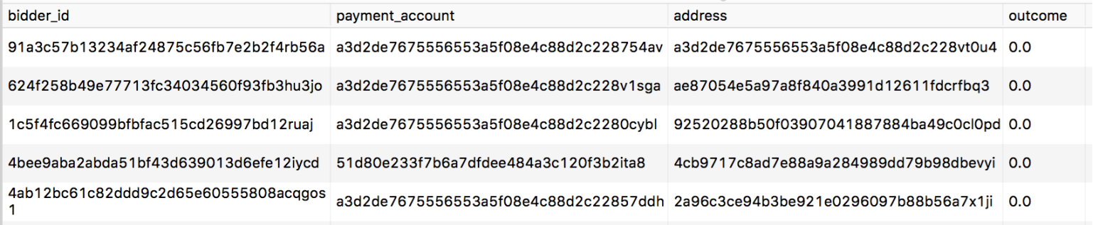
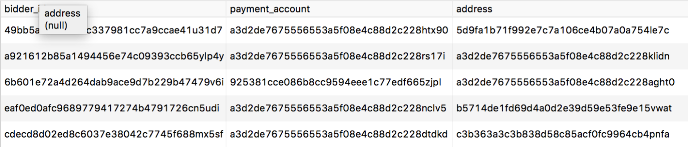
Understanding data: Bidders
bidders_train table (size: 2 013 = 1 910 for humans + 103 for robots)
Insights:
payment_account is uninformative
address is uninformative
many of the outcomes were hand labelled and some were stats based
(hence) dataset is imbalanced (95 : 5)
the data is noisy and messy
bidders_test table (size: 4*700)

Slide 7
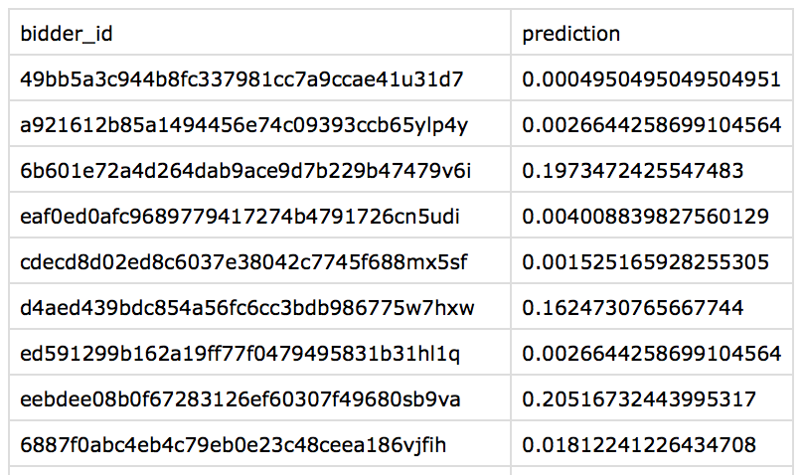
Understanding goals
Having bidders’ information in the train and test table & their activities in the bids table we have to combine & process them to create feature vectors for every bidder; then use it as a train & test data for solving classification problem.
The submission file looks like this. Prediction stands for prediction of the probability that the bidder is a robot.

Slide 8
A few thoughts...
average bids per robot: 2145.0
average bids per human: 936.0
average bids per auction by robot: 34.0
average bids per auction by human: 115.0
average bids per device by robot: 69.0
average bids per device by human: 292.0
average bids per ip by robots: 1.0
average bids per ip by human: 2.0
average bids per url by robot: 4.0
average bids per url by human: 3.0
From the above, we can see distinct difference between bids made by human and bots per auction, per device. Features related to number of bids, auction, device draw our attention.

Slide 9
Feature engineering
One of the main problems is which features should be generated for a good representation of bidder’s behaviour.
Features that was created:
timediffs - bidding time difference per user (bidder_id)
bids_per_auction - number of bids a user made per auction
pbots_country - proportion of bots for each country
pbots_device - proportion of bots per device
ip_bids_ratio - number of unique ip to number of bids ratio
auction_url_entropy - mean per auction url entropy for each user

Slide 10
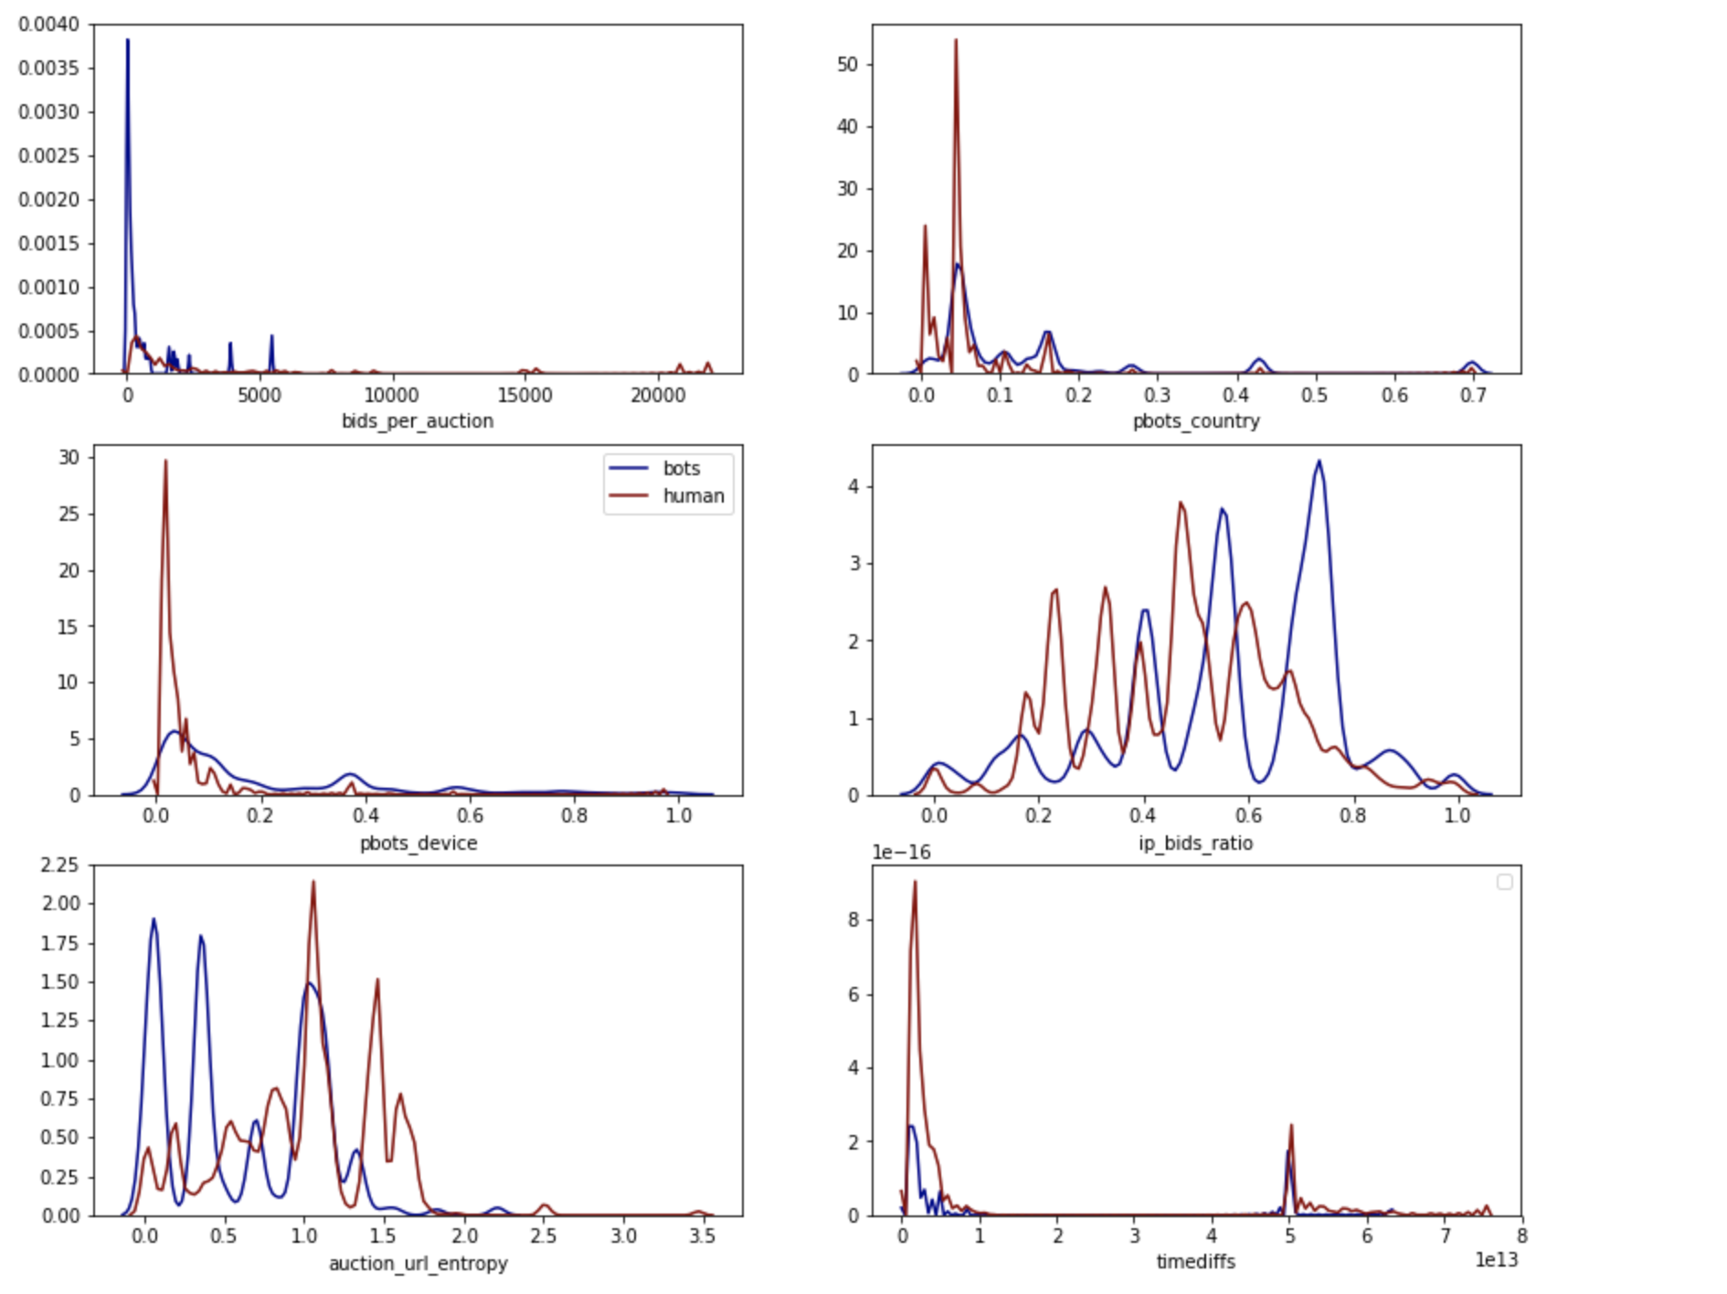
Time Diff Distribution human vs Robot
Since the variable timediff (time differ per user) showed a similar distribution between robots and human. It also has no clearly correlation with our outcome. Therefore, this variable may not be very helpful when we are fitting a model. In contrast, we may even have overfitting problems if we incorporate it in our models. Therefore, we will ignore the variable timediff during the modeling process.

Slide 11
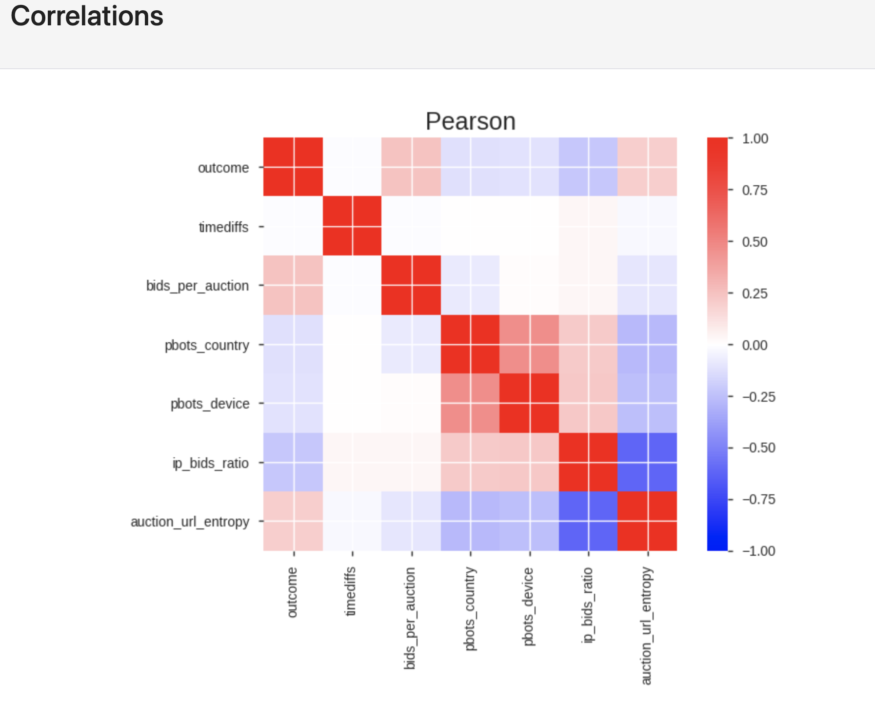
As we can see outcome has a higher linear relationship with auction_url_entropy and bids_per_auction.
More feature engineering can be captured from the HTML file.

Slide 12
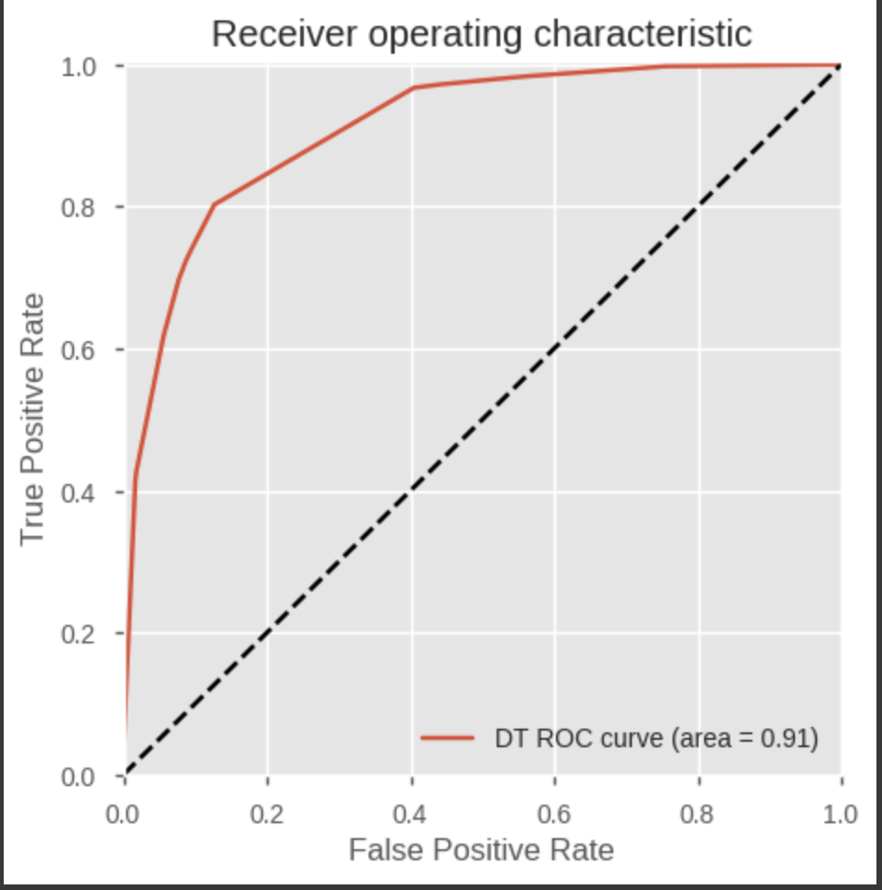
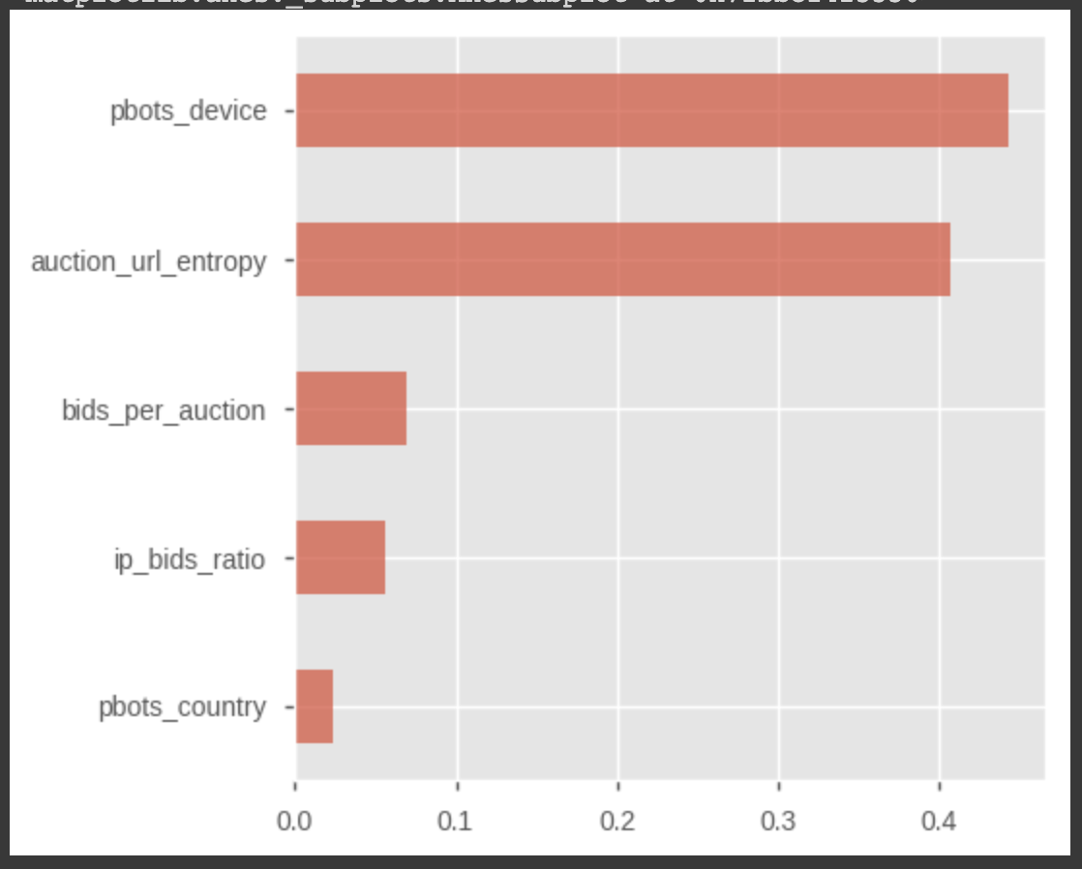
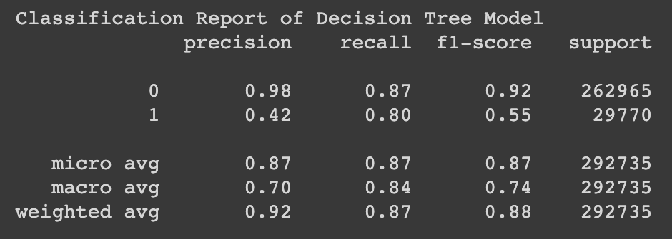
Building Model: Decision Tree

Slide 13
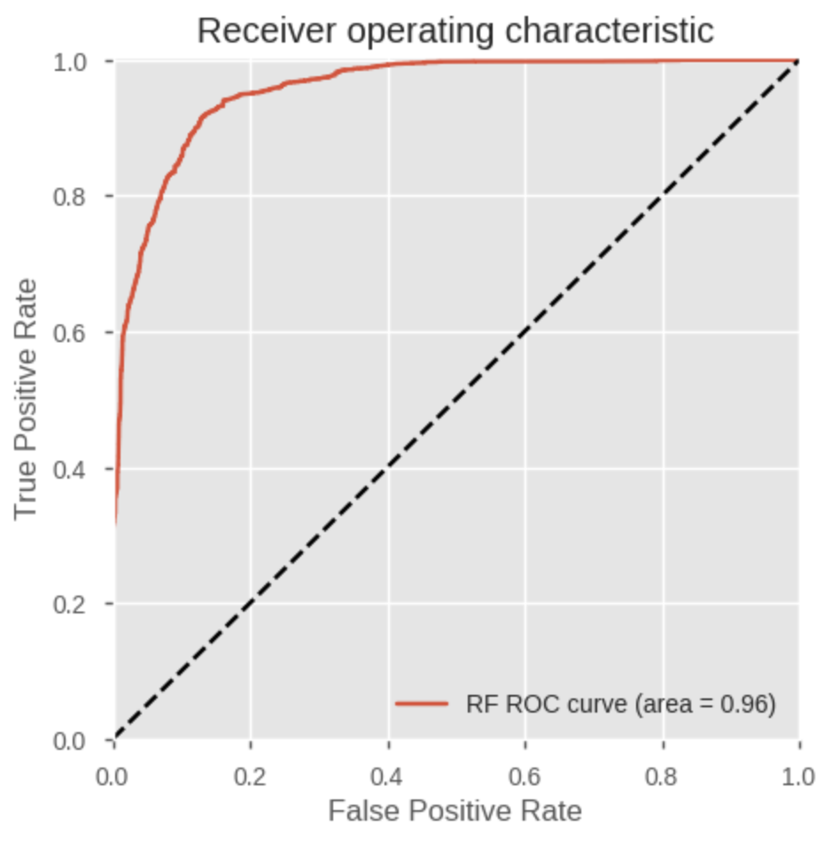
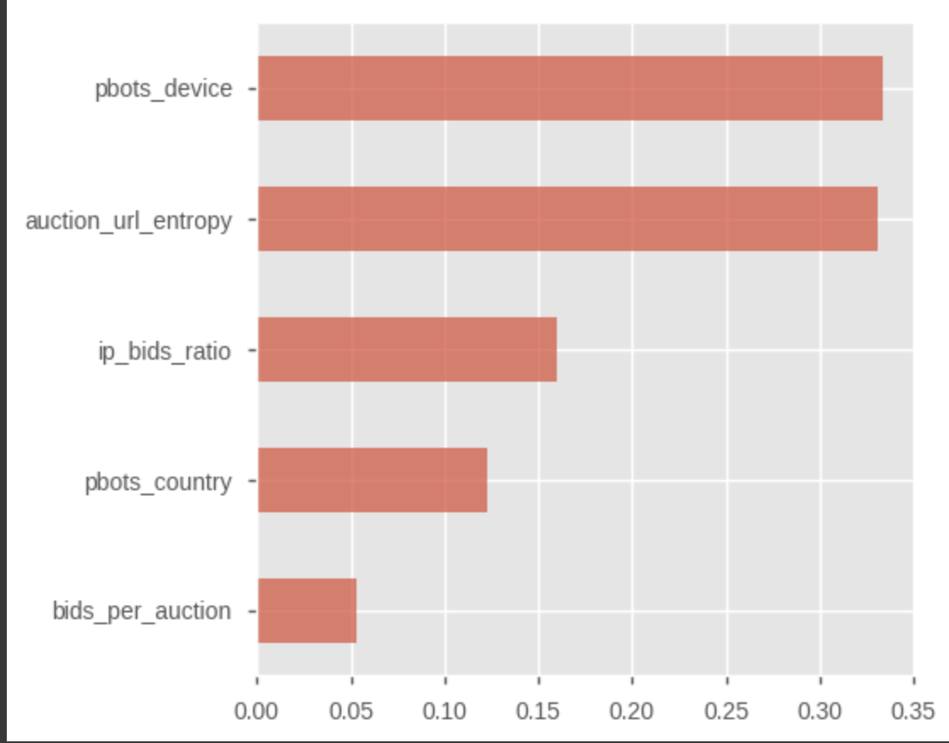
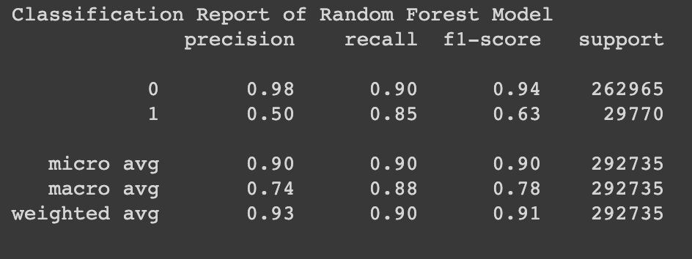
Building Model: Random Forest

Slide 14
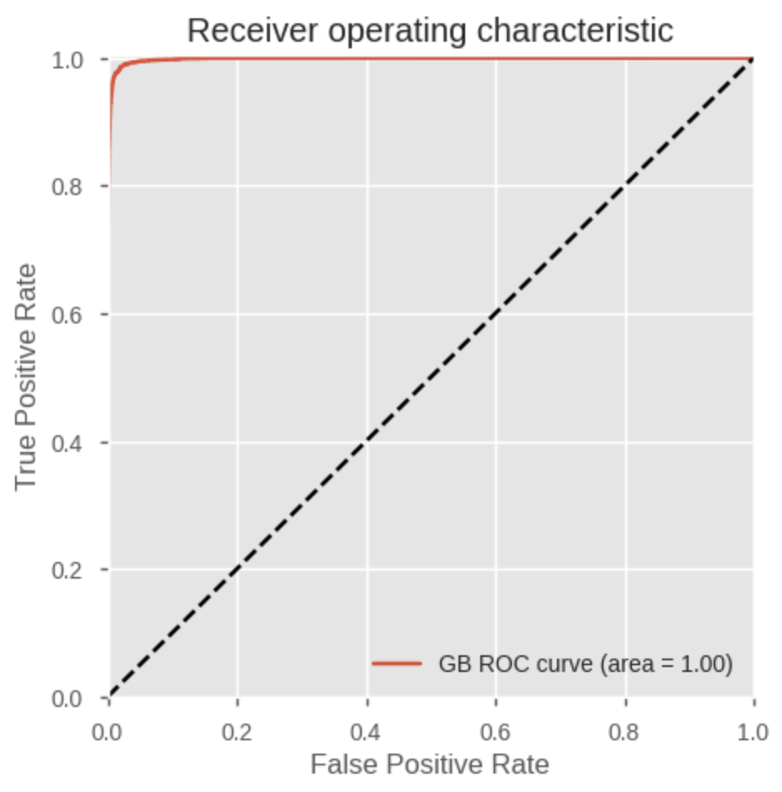
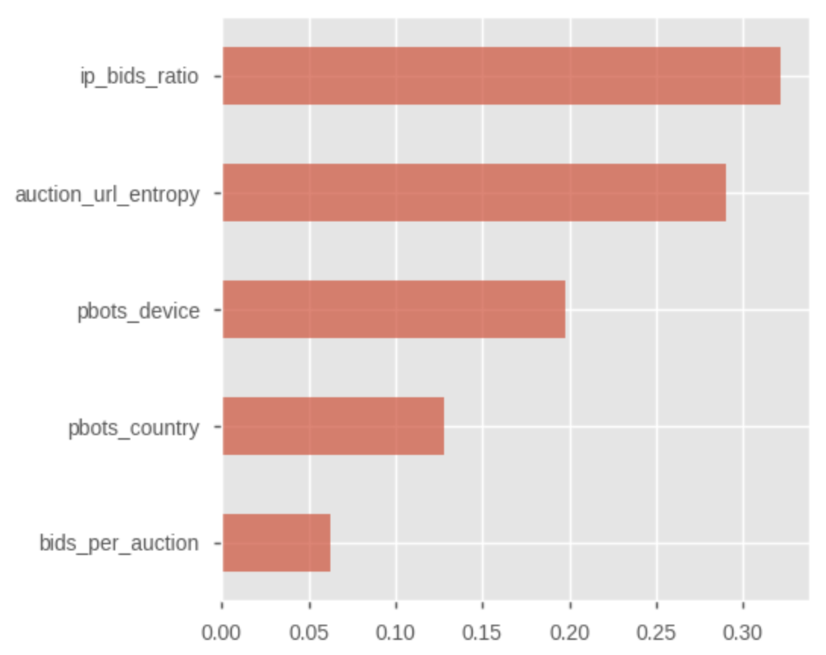
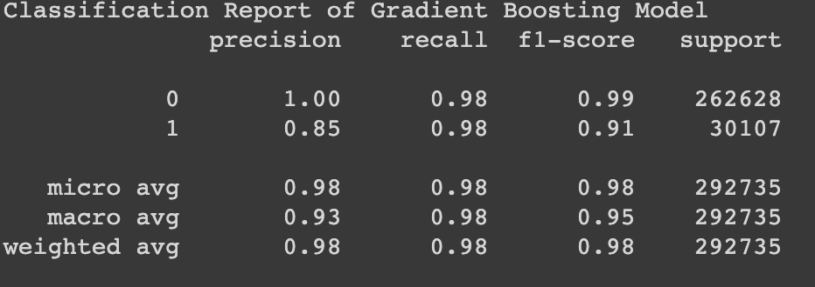
Building Model: XGBoost

Slide 15
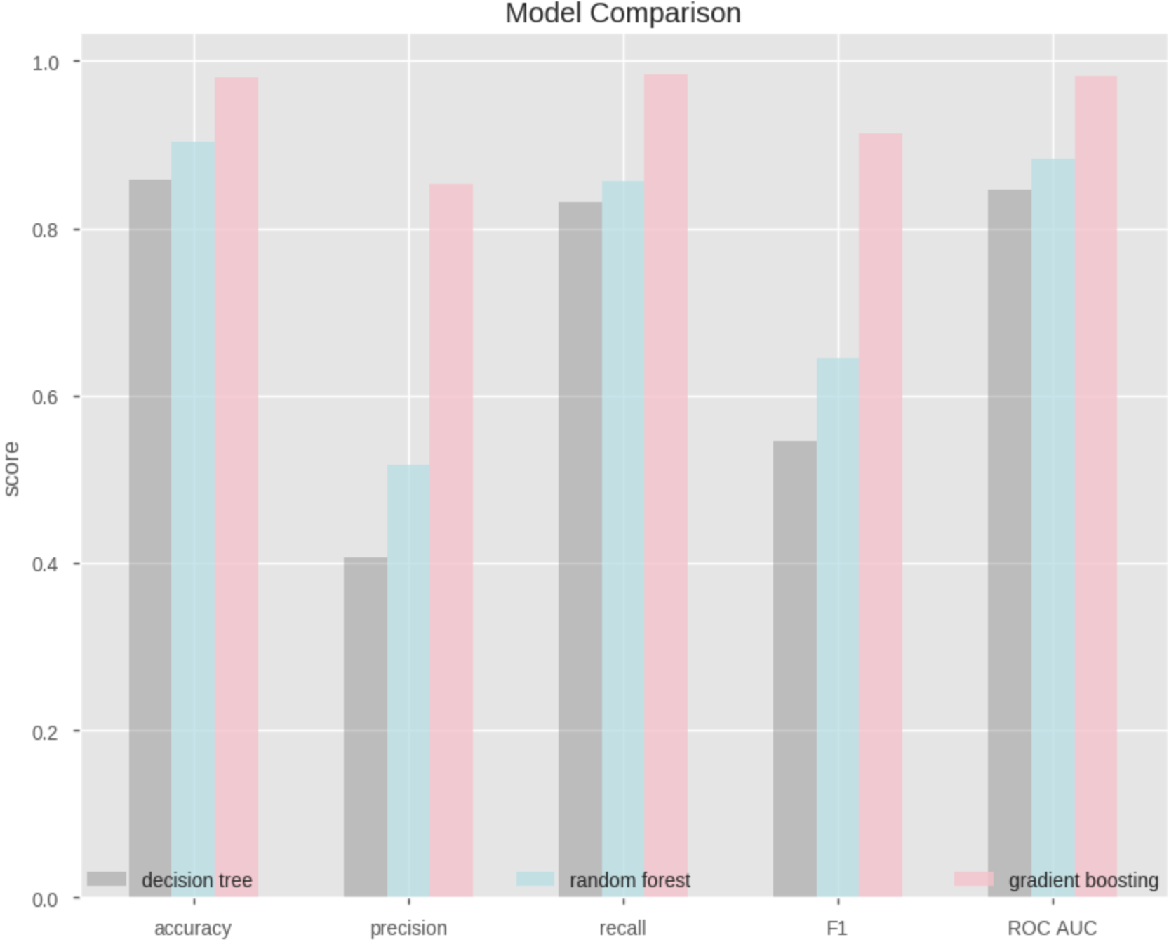
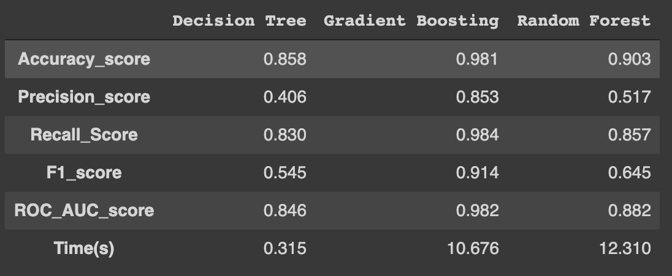
Building Model: Model Comparision
As we can see even though the fitting time of decision time is pretty fast, however, the preformance of it is not acceptable. The Gradient boosting model has the best performance and not cost as much time as random forest model. Thus we choose gradient boosting model as our final model.

Slide 16
THANK YOU!

